Slide 1
Мongolian children foundation

Slide 2
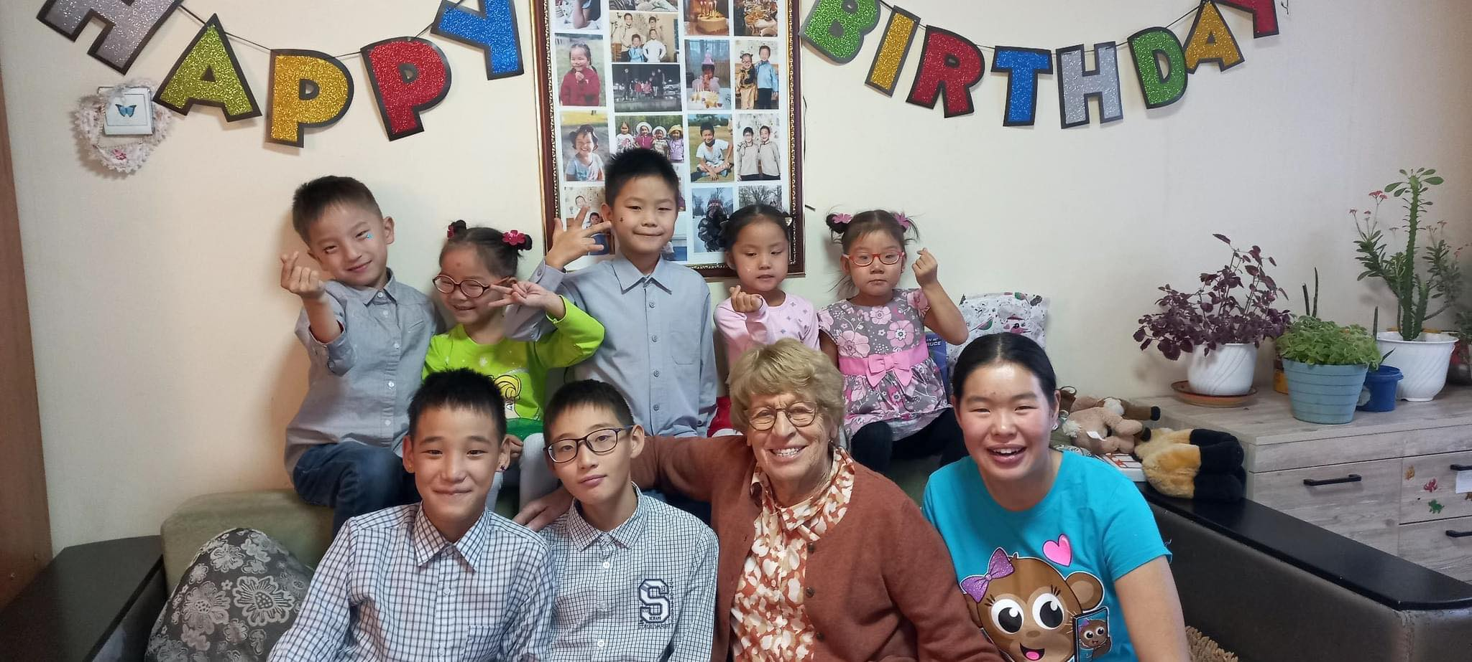
Here is Corry, She is our hero. She is a missionary who founded this organization in 2001. She founded Asian foundation in Holland 1999, To support Mongolian children foundation. Since 2001, we helped more than 200 children in Mongolia. Our mission is to give them loving home, opportunity to study, bring gospel and raise them in Christian way for those children who has no access to study, to be nurtured, to revieve love and homless children. We are now looking after 50 children through our foster homes.

Slide 3
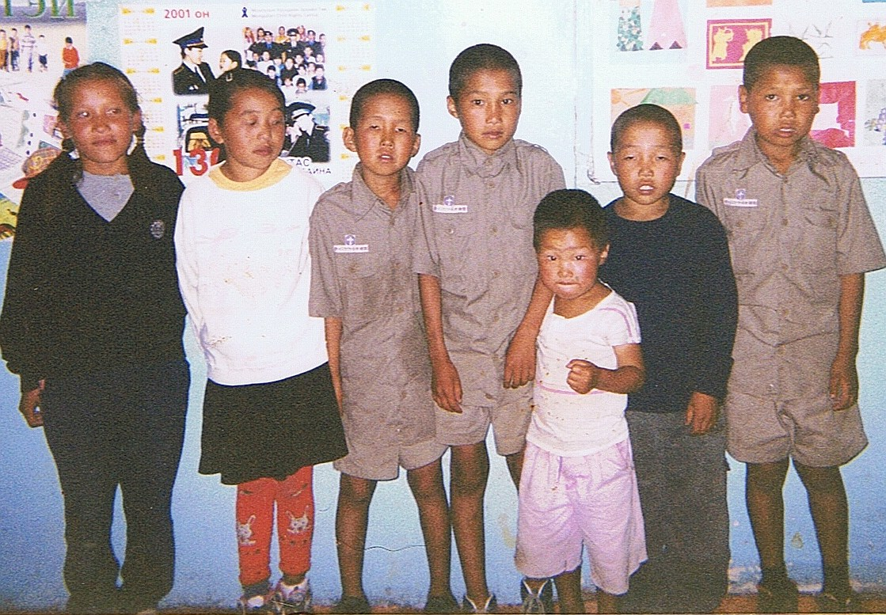
50%
Mongolian children foundation founded in 2001 with 7 children. We took these 7 children from state orphanage. In that time there were many children but we could take care of only 7.

Slide 4
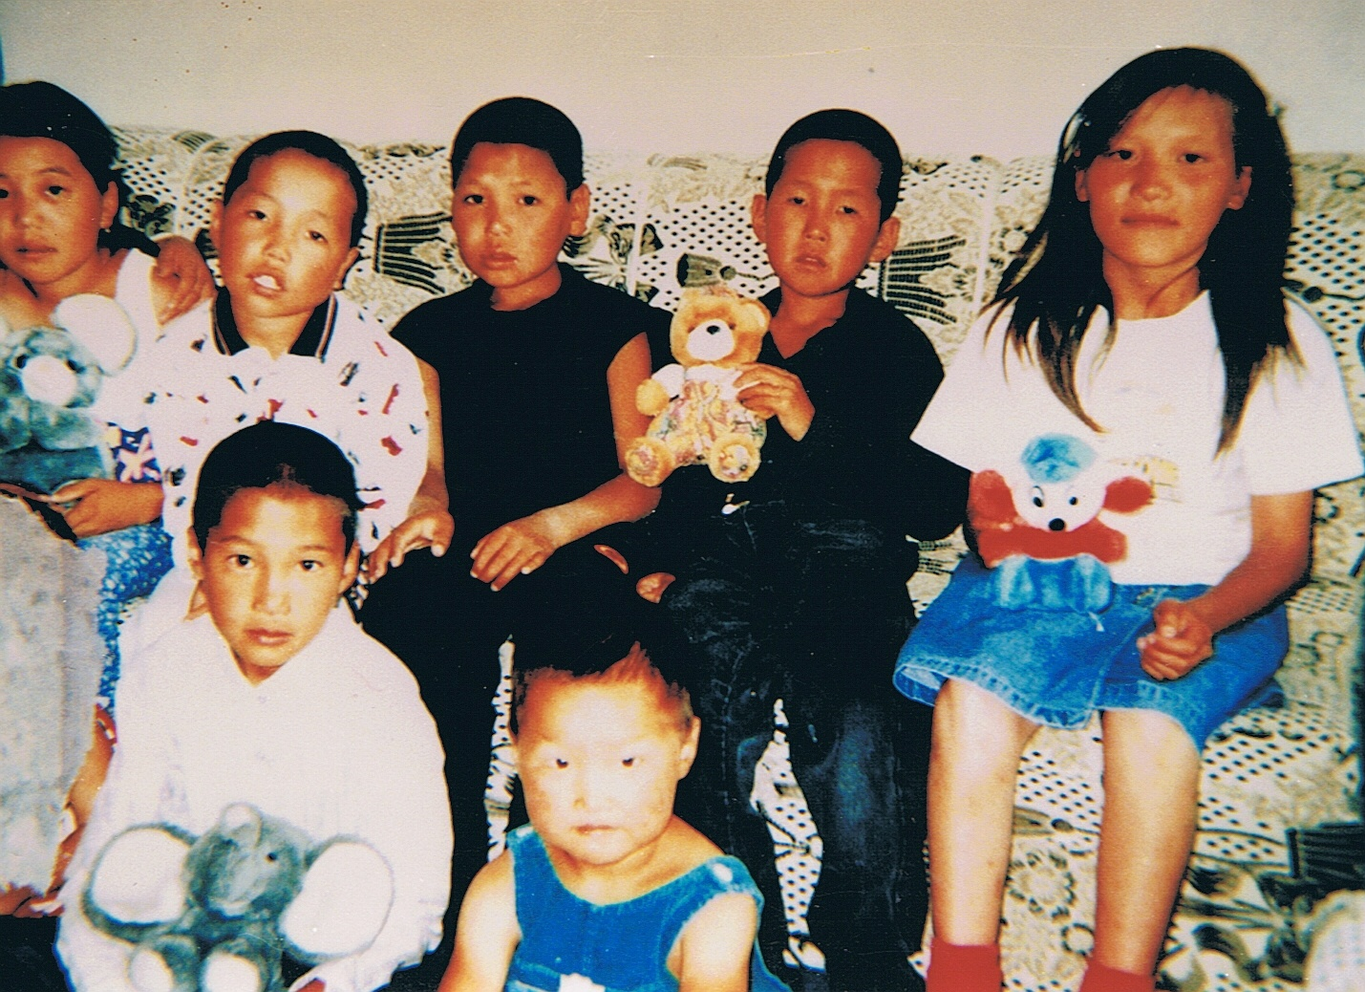
We brought them in our first foster home. They treated each other like brother and sisiters.

Slide 5
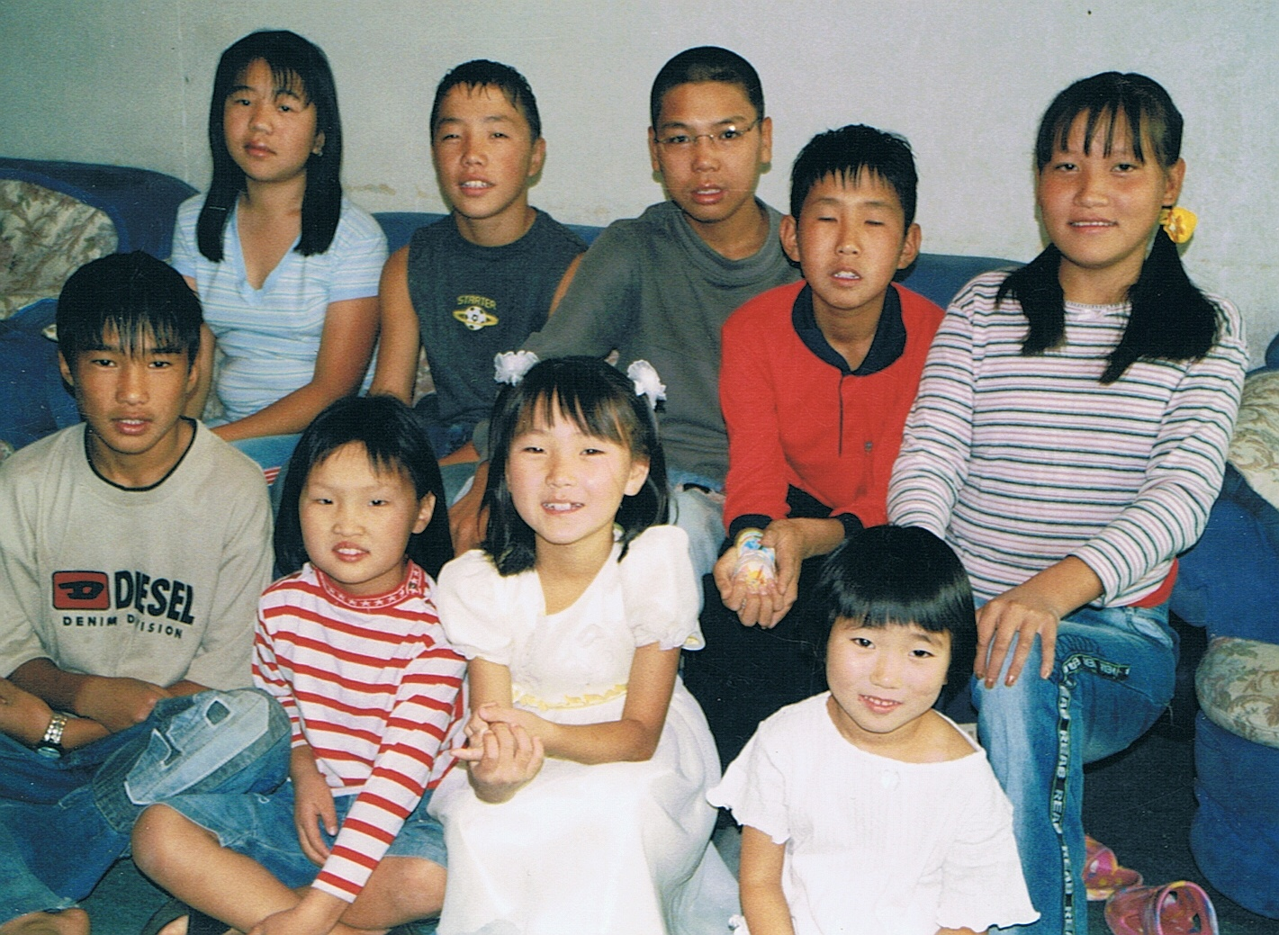
These are the first 7 children after many years with us. And some of them are new children.

Slide 6
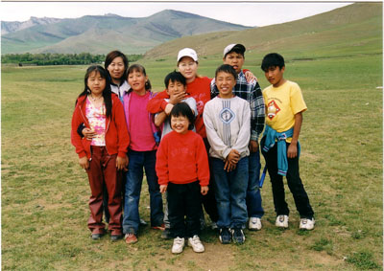
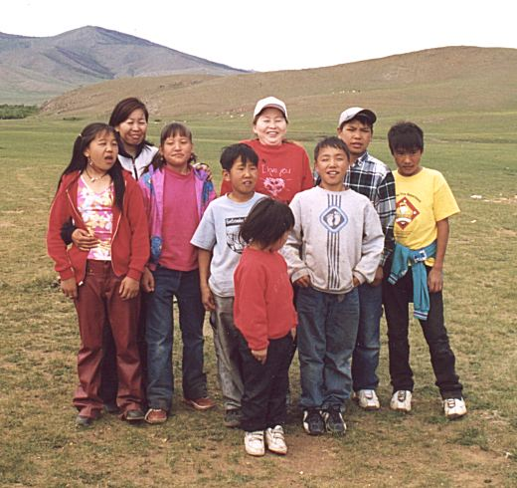
We take them to out of city for day trip for weekend and during school holiday time.

Slide 7
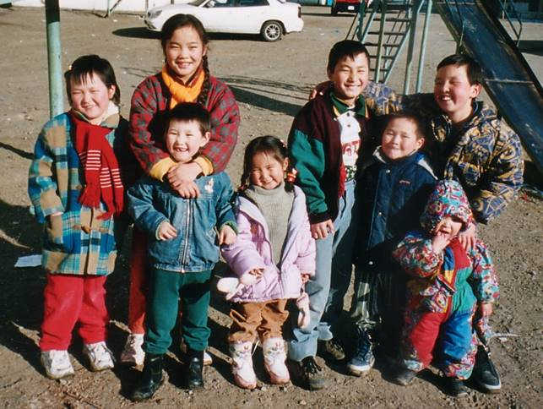
In 2002 we opened our second foster home with 8 children.

Slide 8
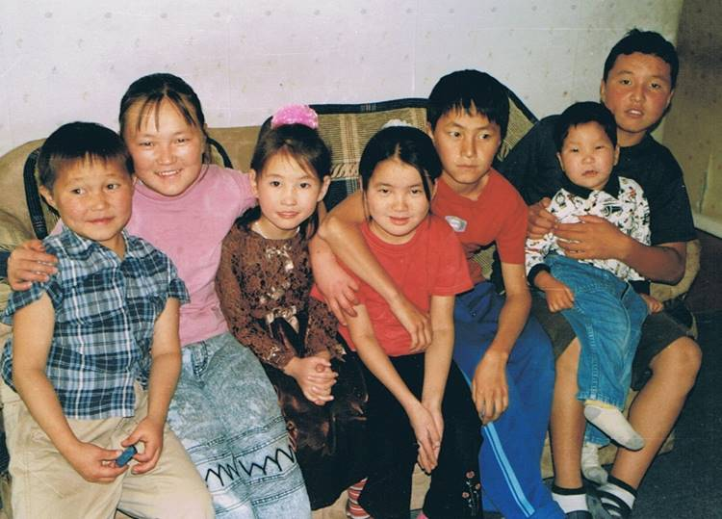
Our foster home- 2 children

Slide 9
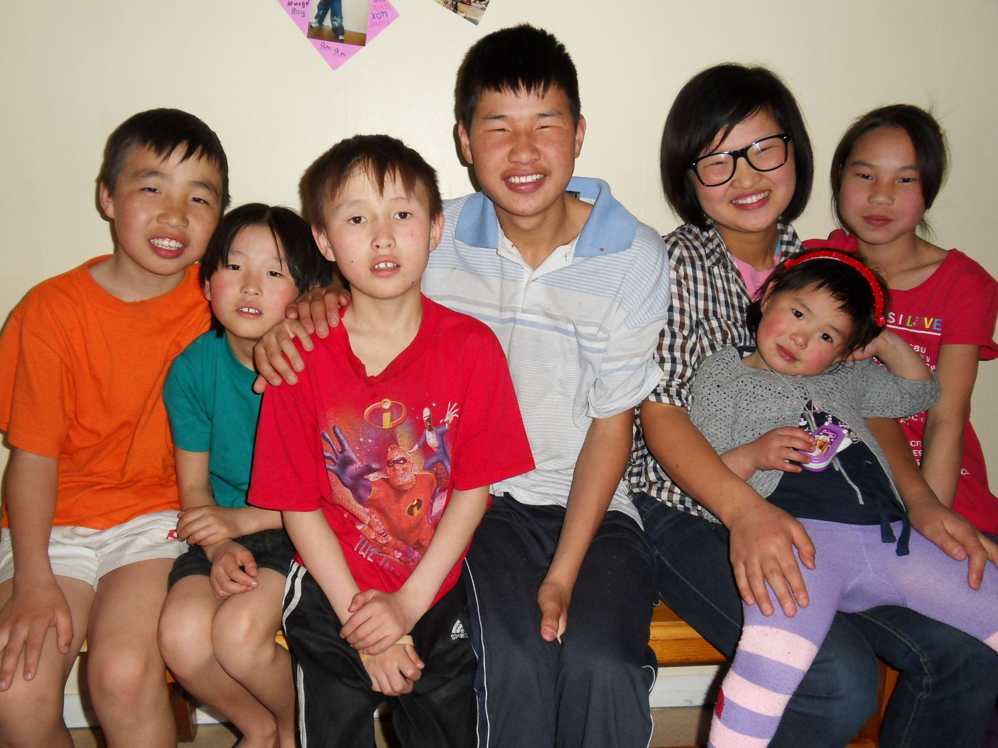
New children in foster home 1 because older children are moved to boys and girls house.
In that time we had gers ( Mongolian yurt) for boys and girls.

Slide 10
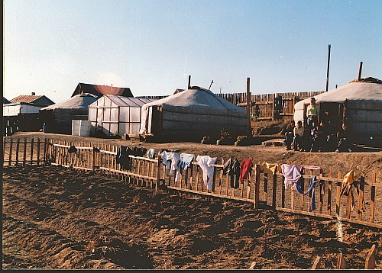
This was our new project for girls. We call it foster homes -3 Because in that time many children were sent out of state orphanage when they turn to 18 years old. So, many children need a place to live and chance to study. So, we opened the girls project so that they had place to live and opertunity to study in collage or universities.

Slide 11
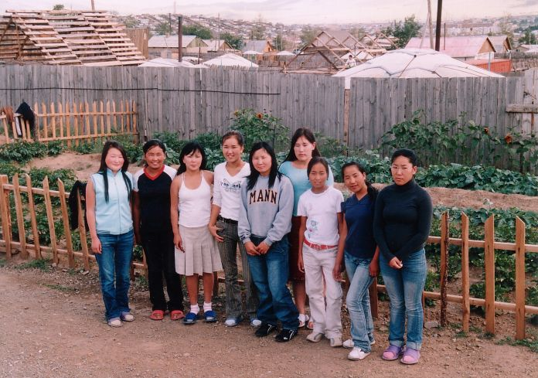
These girls were the first girls who came from state orphanage. Because they were sent out of state orphanage. So, we gave them home to live and chance to study.

Slide 12
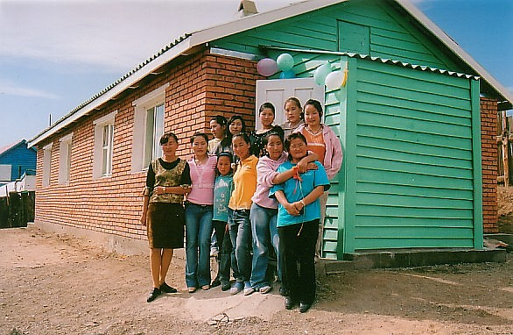
First we started our girls project with gers but after some years we build our first little house for these girls.

Slide 13
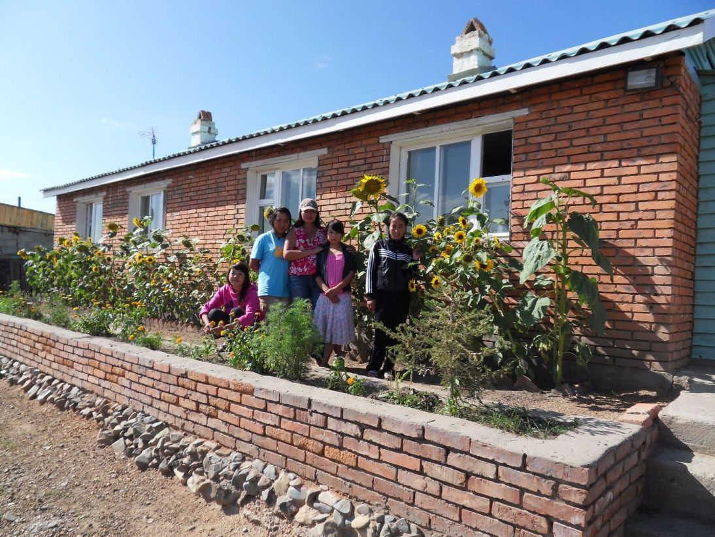

Slide 14
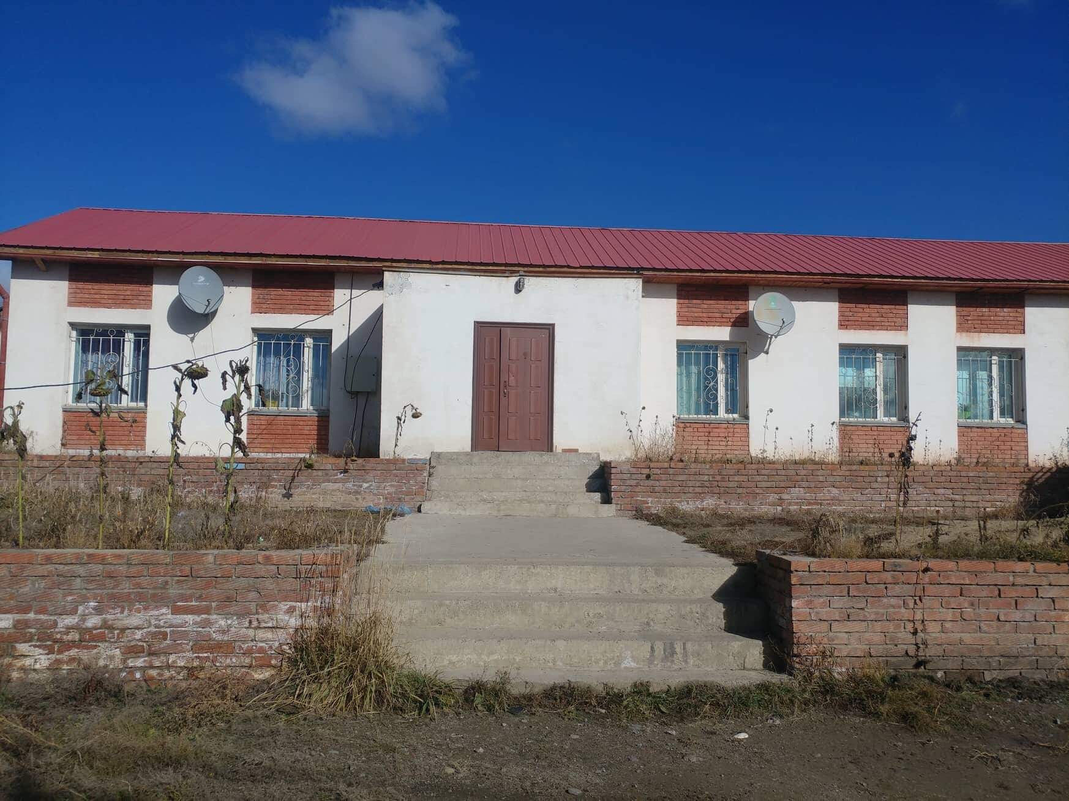
2010 we got some money from Dutch embassy in Beijing, China for the new house for girls. So that we could look after more girls.

Slide 15
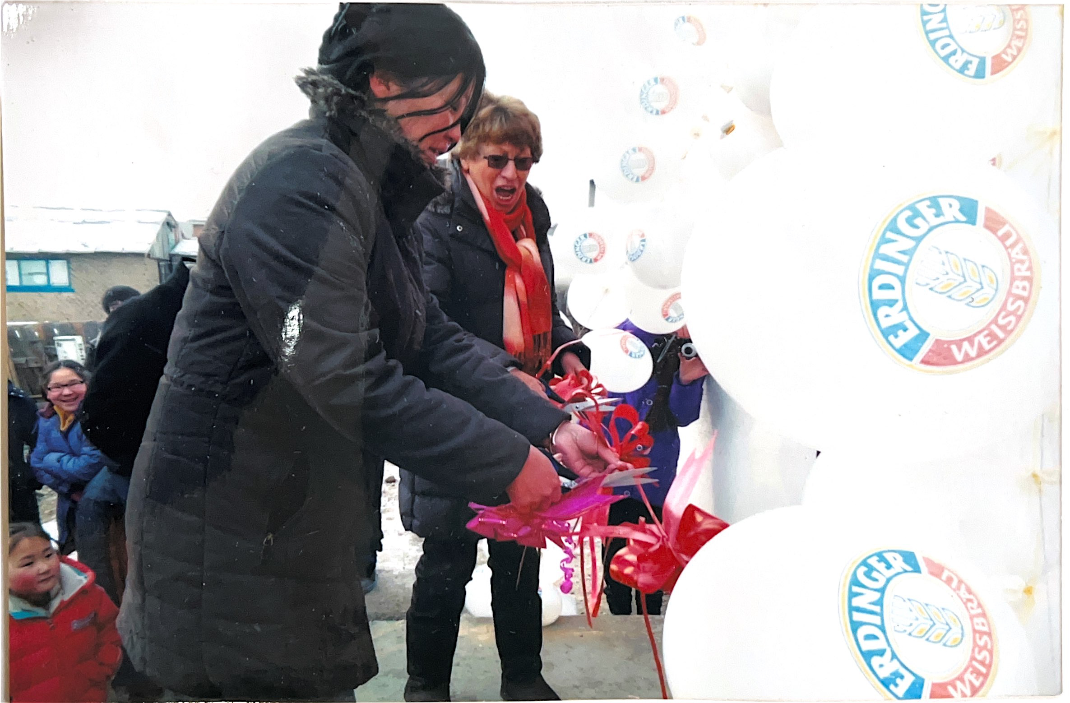
Openning our new house for girls.

Slide 16
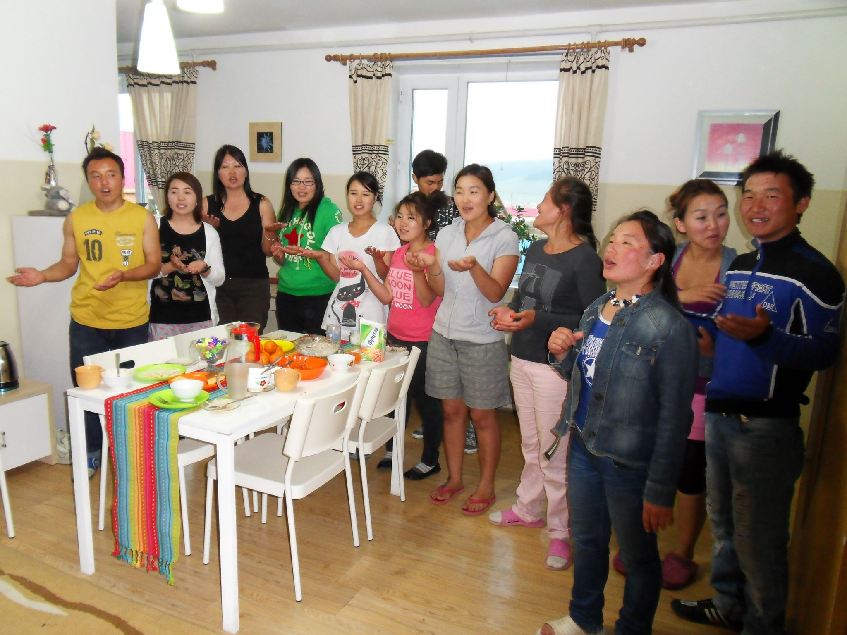
Girls

Slide 17
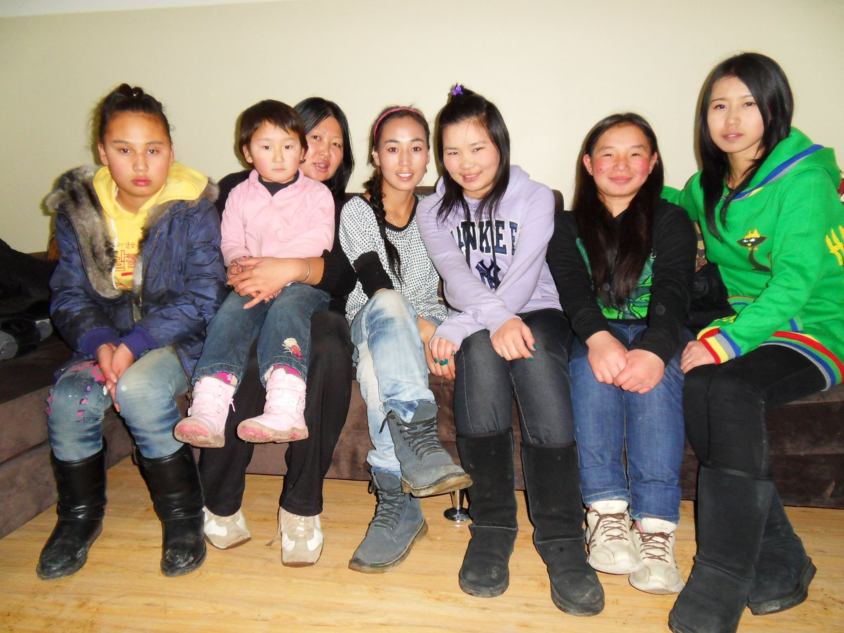
Our new girls in our new girls house.

Slide 18
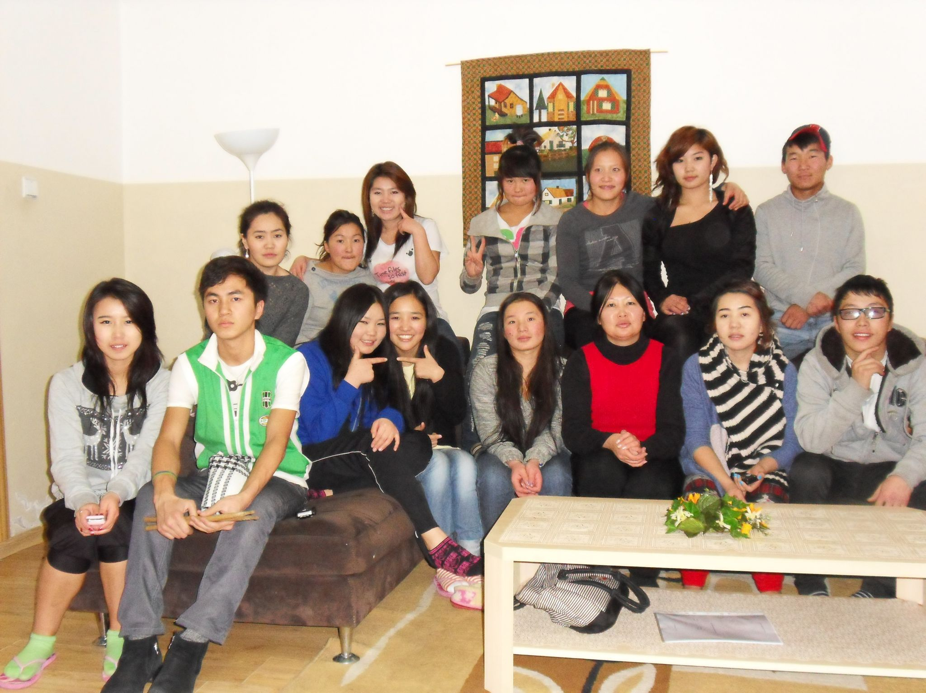
These are girls from girls house and we had gers for students boys near by girls house.

Slide 19
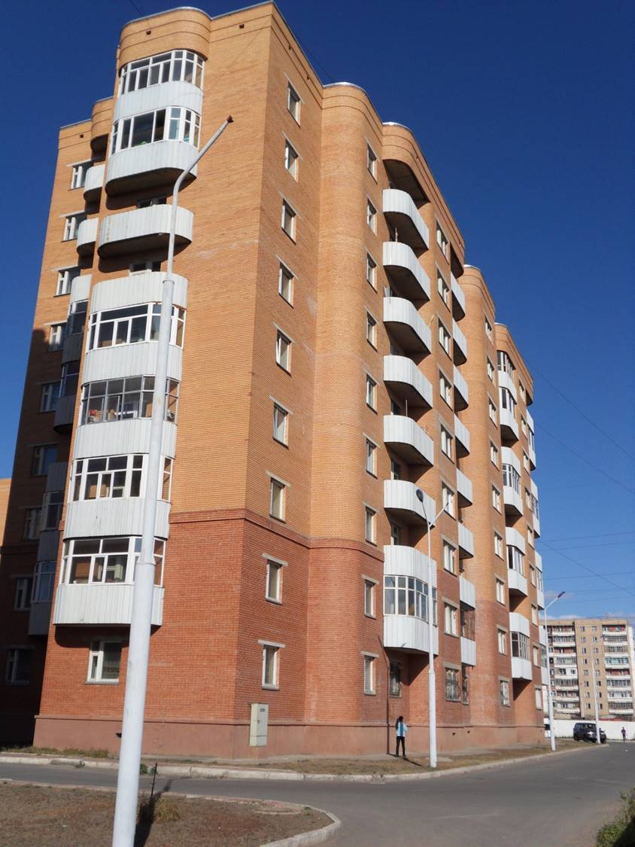
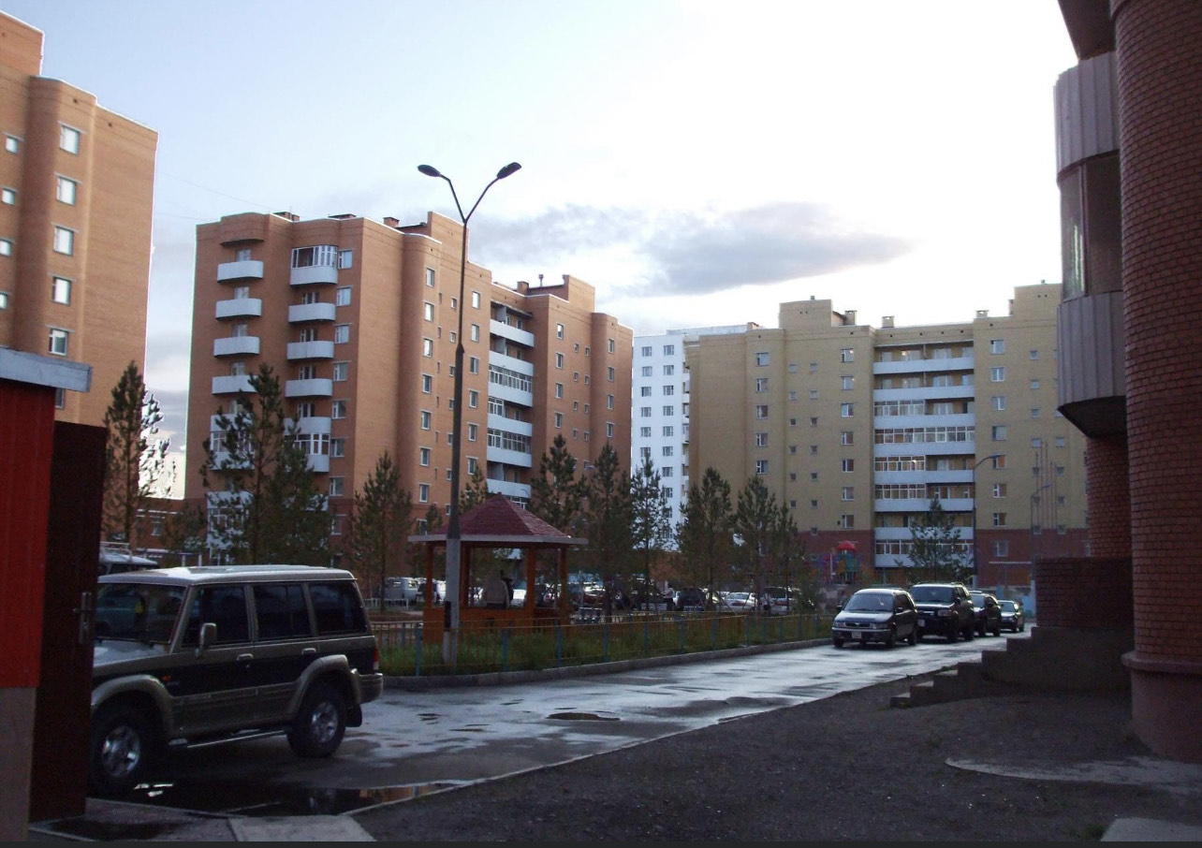
2009 we bought our 4rd foster home house. This house was from our former pastor Rob. Who was missionare in Mongolia.

Slide 20
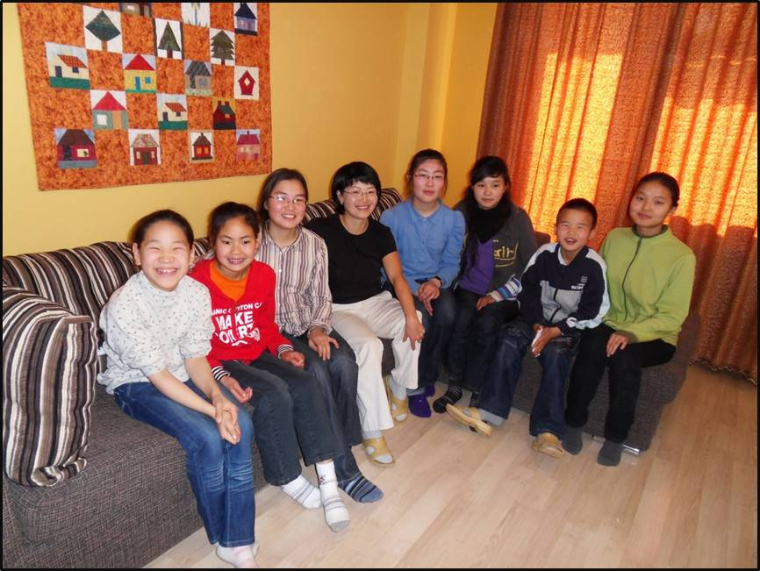
These are our new children in our foster home 4. We started with 9 children but now there are 11 children living in that home.

Slide 21
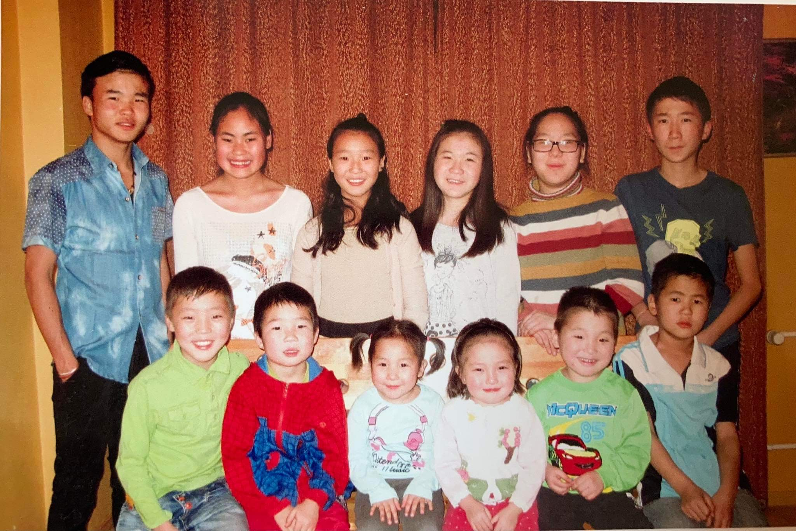
Foster home 4 pictures, this photo is taken by 2017

Slide 22
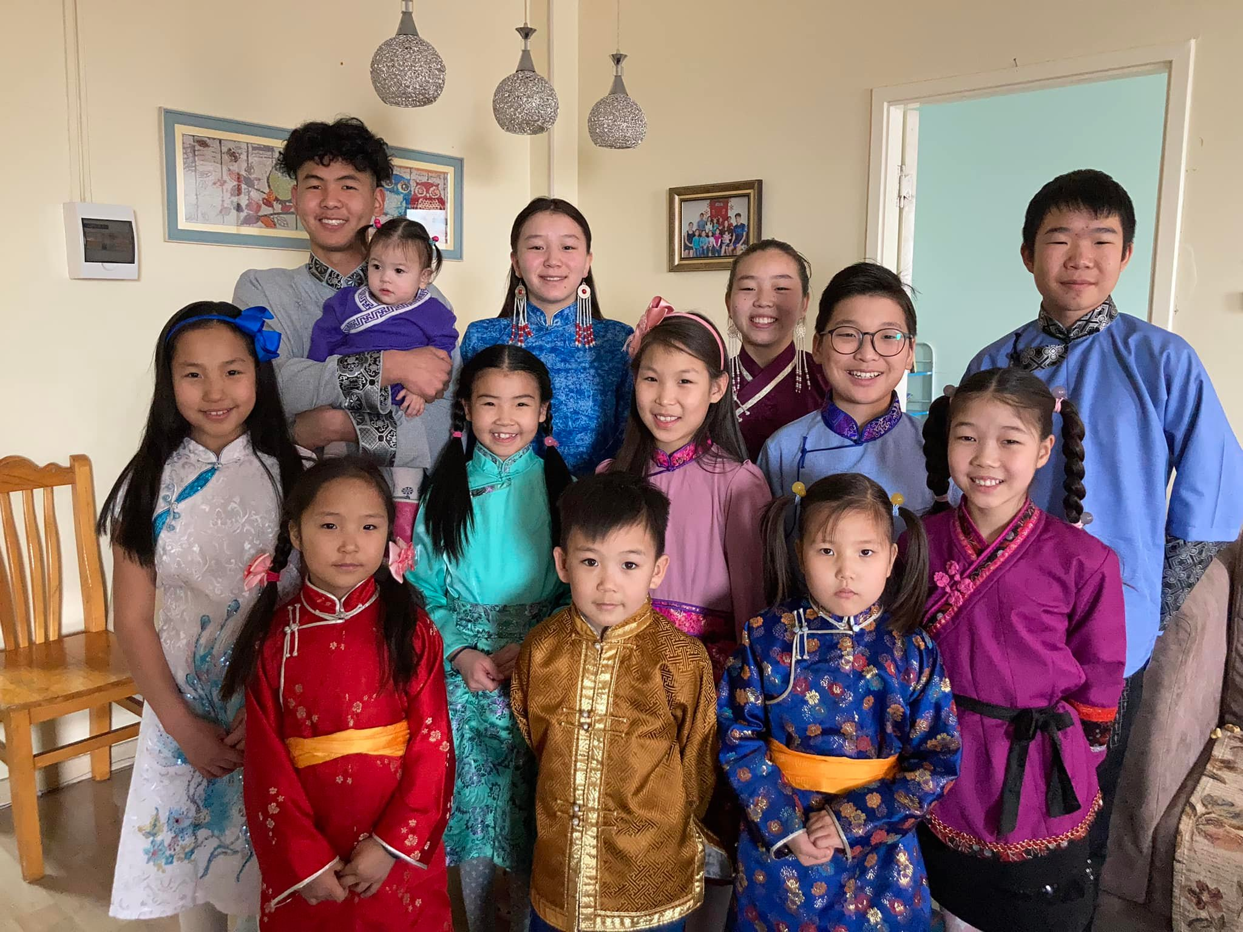
Our traditional celebration called luner year.

Slide 23
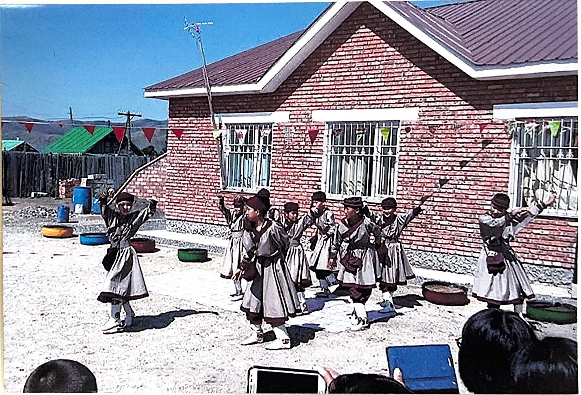
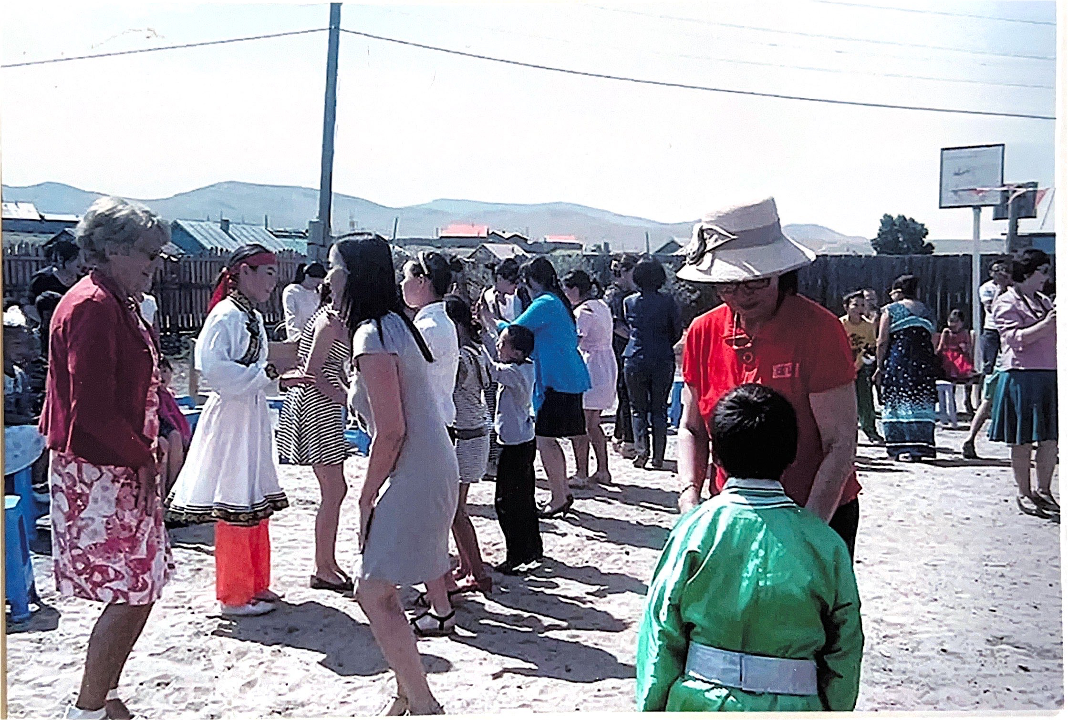
Our new child protection center in countryside. One of Christian Tv ( EO-evangelische Omroep) in Netherlands made Tv programme about Mongolia and our work in Mongolia. Because of this programme people gave money for our project and we got money to have another children home in countryside.

Slide 24
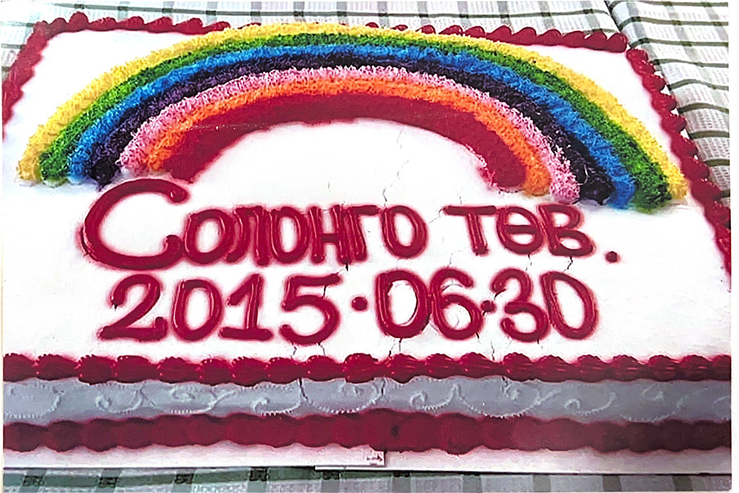
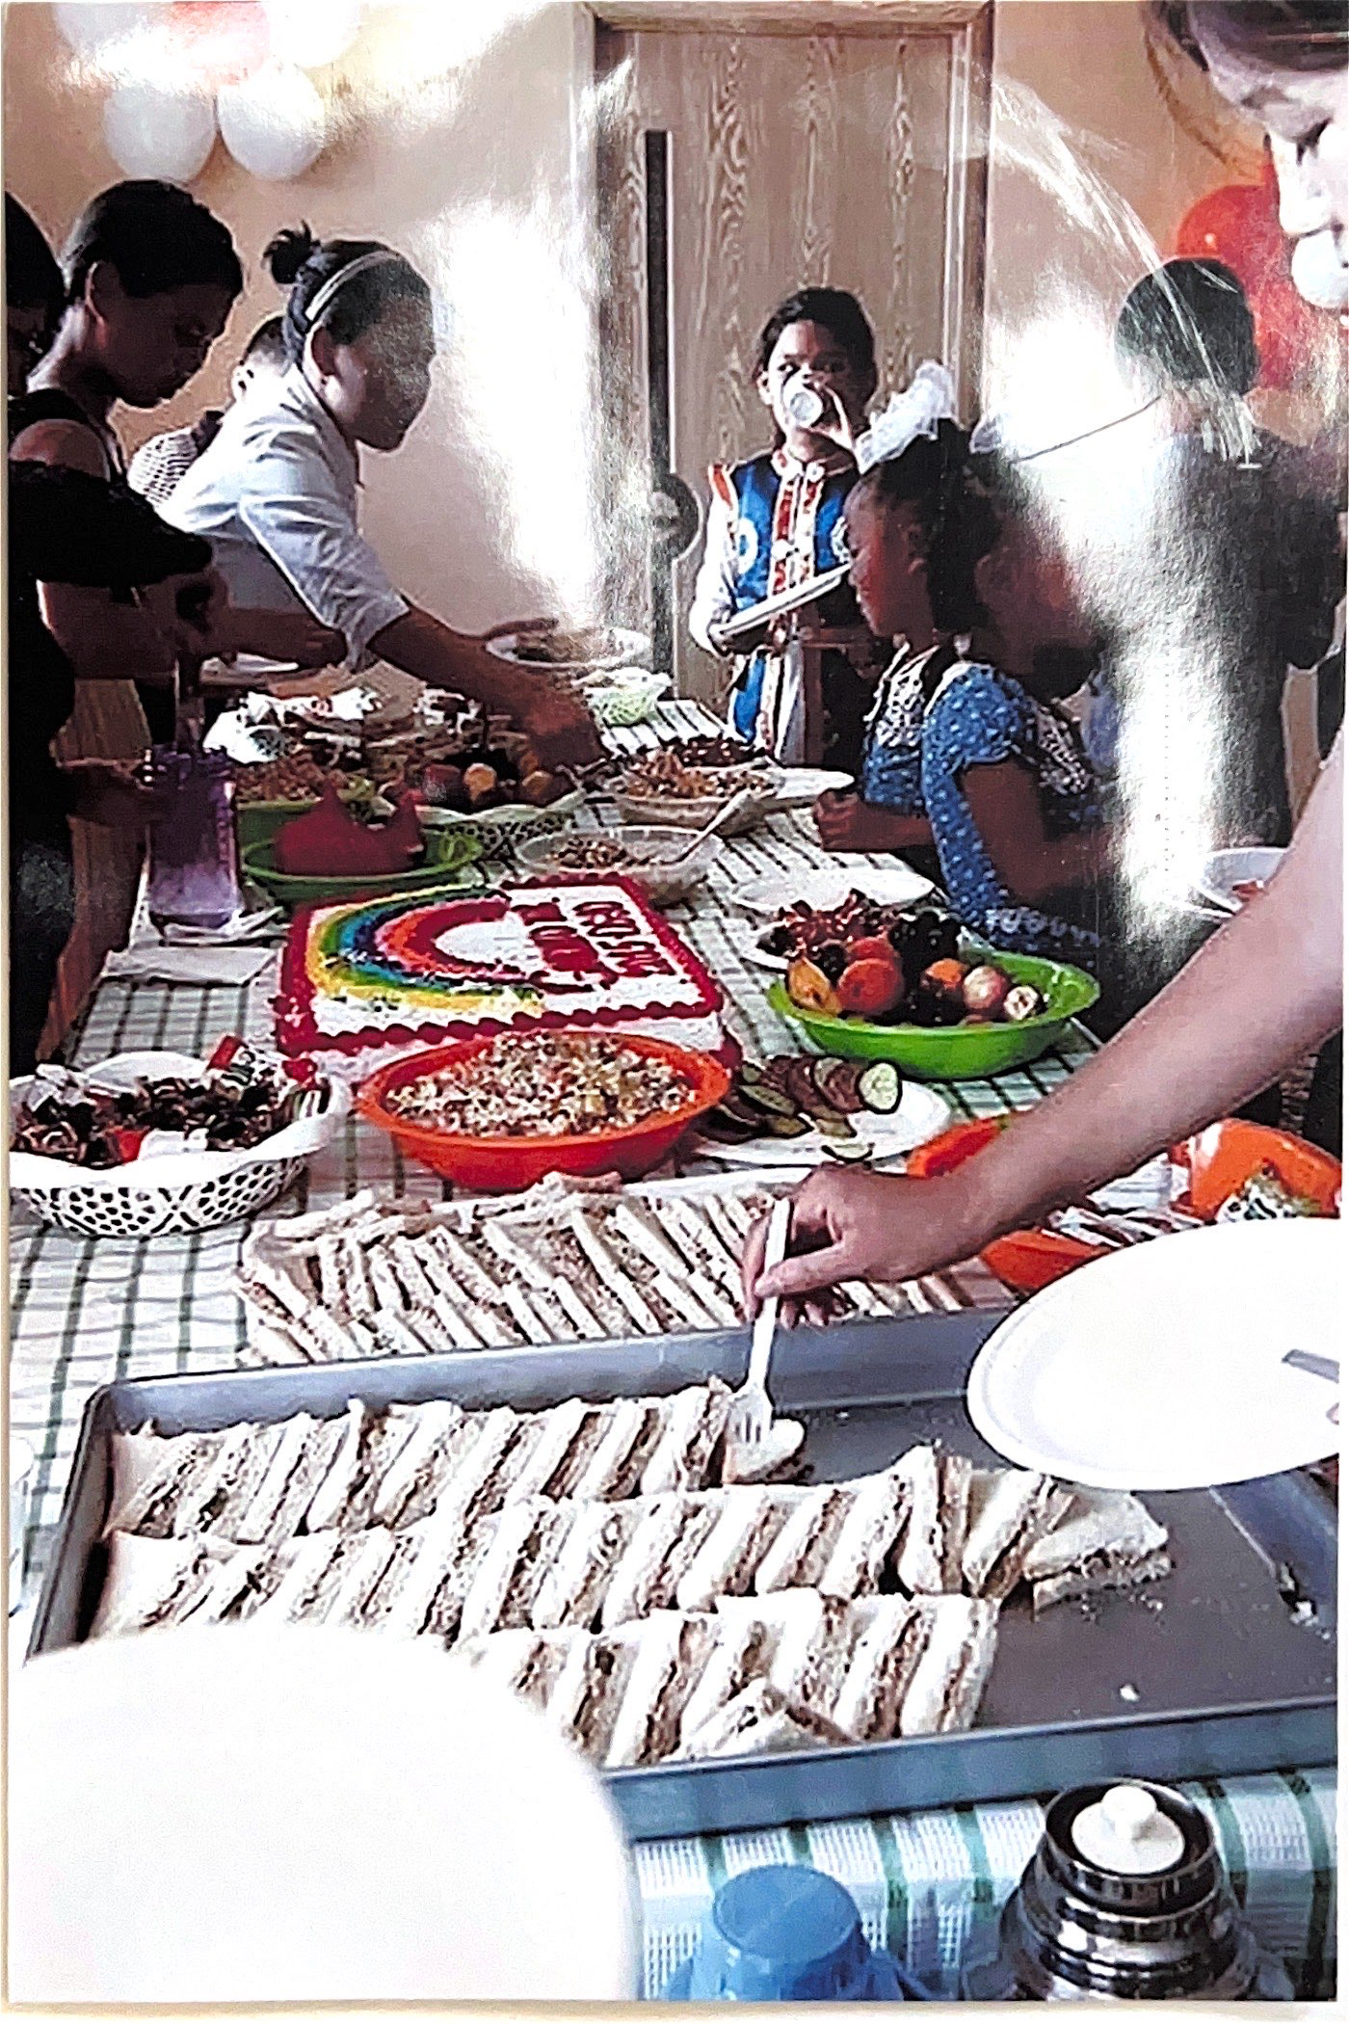
Official opening of child protection center in Kharhororin, Ovorkhangai province.

Slide 25
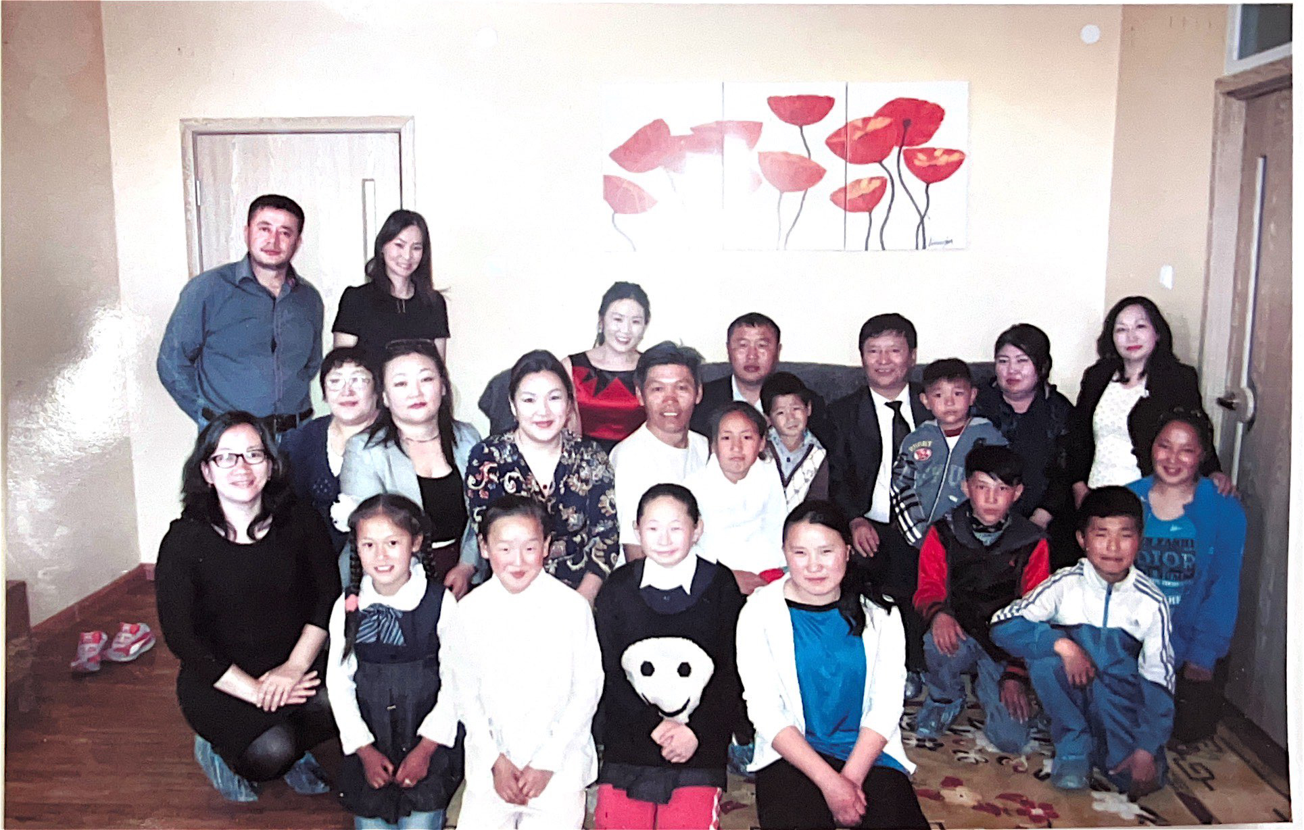
These are our first children in our center in countryside with local government people.

Slide 26
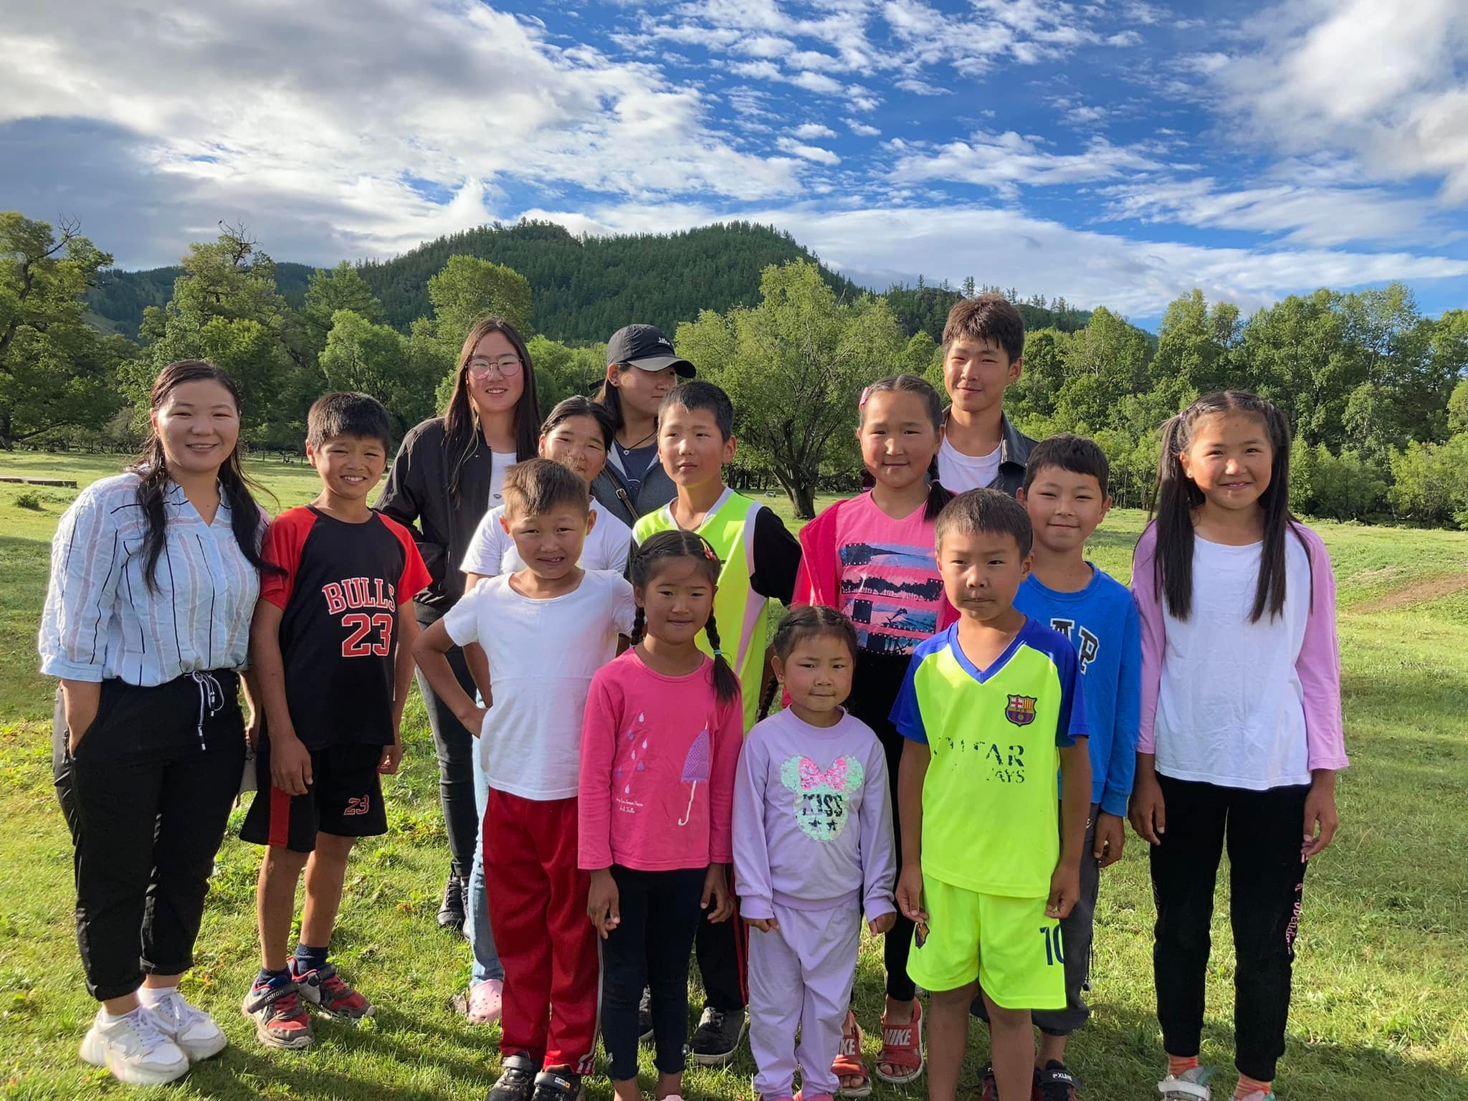
These children are living in foster home in countryside by 2023.

Slide 27
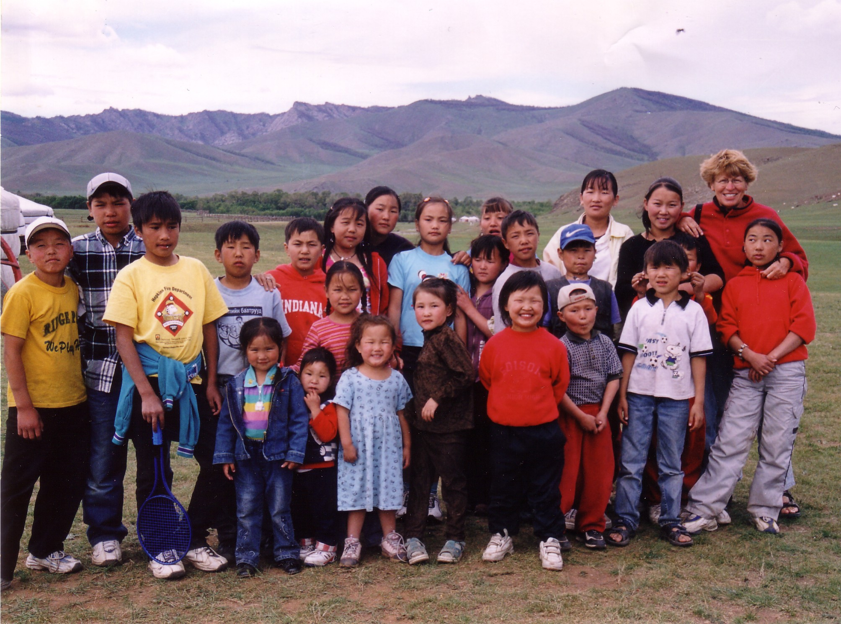
Our first children camp in 2003. We still do every year children camp and we learn more about Jesus at camp. There is Corry she is the missionare woman who started this foundation.

Slide 28
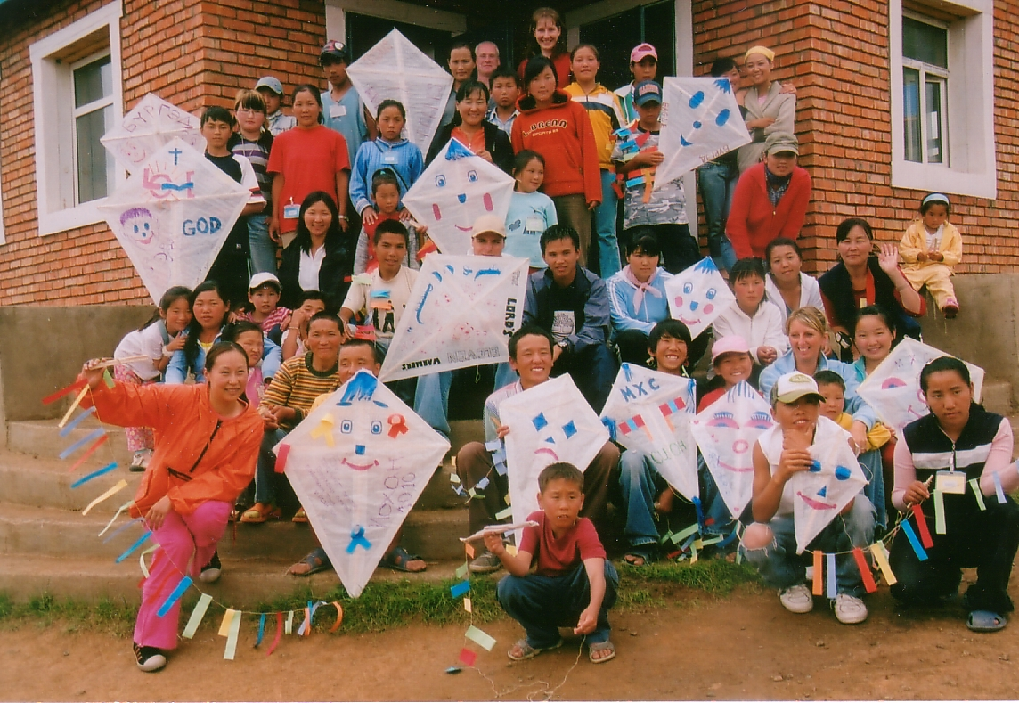
In 2007, we had first English team at our camp from kingdom faith church in UK,

Slide 29
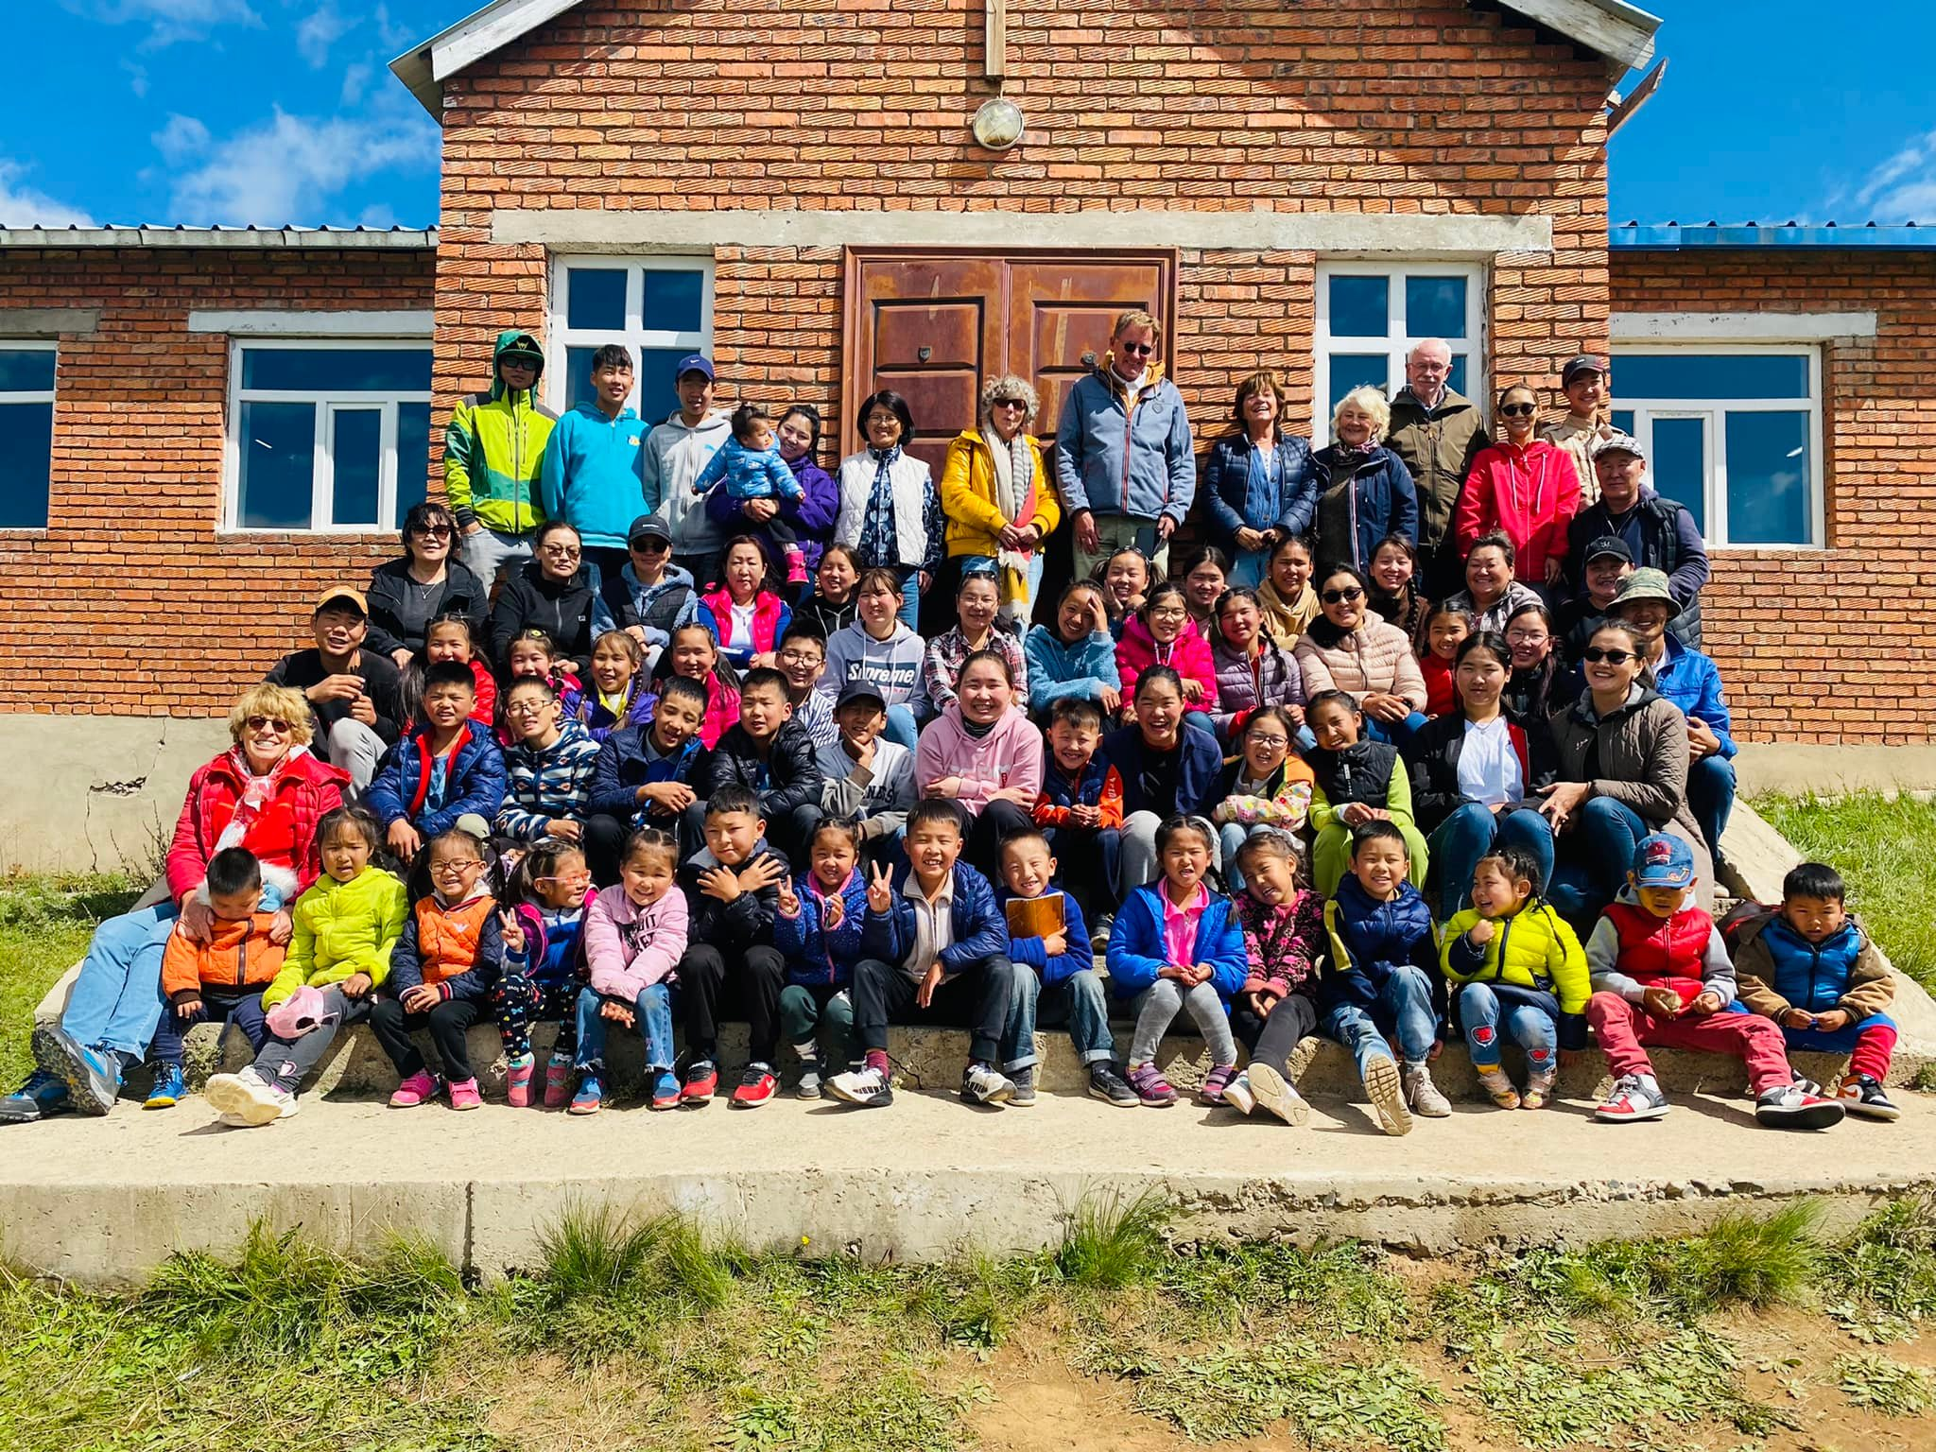
This was at camp 2022, We celebrated our 20th year anniversary. Due to Covid we couldn’t celebrate in 2001. There are board members from Holland who are doing this job for free, absolutely submitted to support Mongolian children foundation to go on. We are grateful for them.

